Slide 1
Hostel Maintenance Request Manager
DSA LAB · MINI PROJECT
A walkthrough of hostel_maintenance.c: how one C program applies arrays, searching, sorting, recursion, stacks, queues, lists, trees and graphs.
Notes:
Introduce the project: a console app where students raise maintenance requests and an admin handles them.

Slide 2
Problem statement
CODE WALKTHROUGH
Build a console application that registers hostel maintenance requests, serves the most urgent ones first and lets students track them, while applying the data structures and algorithms from the DSA course.
Lost requests
No priority
No visibility
Complaints raised verbally or on paper are easily forgotten.
A burst pipe can wait behind a broken chair when work goes first come, first served.
Students cannot see whether anyone has picked up their request.
Hostel Maintenance Request Manager · 2/12

Slide 3
Objectives
CODE WALKTHROUGH
1
Array
Keep every request in a register sorted by ID
registerRequest()
removeRequest()
2
Find requests fast and compare three sorting algorithms
Search and sort
searchById()
sortMenu()
3
Use recursion for counts, urgency score and tree walks
Recursion
countStatusRec()
traverse()
4
Support undo, an urgent-first work queue and a resolved log
Stack, queue, list
push() cqEnqueue()
showLog()
5
BST and graph
Index request IDs and plan technician routes
bstInsert()
bfs() dfs()
Hostel Maintenance Request Manager · 3/12

Slide 4
Methodology
CODE WALKTHROUGH
1 Analyse
2 Design
3 Implement
4 Test and analyse
Two roles, the request fields and the Pending, Assigned, Resolved flow.
Pick one data structure for each need: array, BST, queue, stack, list, graph.
One C file using only the standard library, with menus run through function pointers.
Run on sample data and count steps, comparisons and time for each algorithm.
Request struct
BST, queue, stack
act[] dispatch
cmpCount, clock()
Hostel Maintenance Request Manager · 4/12

Slide 5
Data model: the Request register
CODE WALKTHROUGH
id, student
Unique ID from nextId (starts at 1001) and the student name.
typedef struct {
int id;
char student[40];
Where the problem is: block A to E, room 101 to 599.
char block; int room;
block, room
char category[20];
char desc[80];
category, desc
One of six categories plus a short description.
int priority; // 1 to 3
int status; // 0 to 2
Priority 1 High, 2 Medium, 3 Low. Status Pending, Assigned or Resolved.
} Request;
priority, status
All requests live in reqs[100], kept sorted by ID. registerRequest() shifts records right to insert in order.
Hostel Maintenance Request Manager · 5/12

Slide 6
BST index: ID to array position
CODE WALKTHROUGH
Insert and search
Delete
Index upkeep
Each node stores an id and its array index. Search is a loop that counts the nodes it visits.
Handles zero, one or two children. With two children it uses the inorder successor.
When array records shift, every stored position is adjusted so the index stays correct.
bstInsert(n, id, idx)
bstSearch(n, id)
bstDelete(n, id)
shiftIdx(root, from, d)
Lookup by ID takes about O(log n) steps instead of scanning the whole array.
Hostel Maintenance Request Manager · 6/12

Slide 7
Circular queue and undo stack
CODE WALKTHROUGH
Circular queue: pending work
Stack: undo
cq[] stores pending request IDs, and front and rear wrap around with the modulo operator. rebuildQueue() refills it by priority, oldest first, and assignNext() dequeues the next job.
Every submit or cancel pushes an Action holding its type and a copy of the request. undoLast() pops it and reverses it. The stack keeps the last 50 actions.
cq[cqRear] = id;
cqRear = (cqRear + 1) % CQ_SIZE;
push(ACT_ADD, r);
pop(&a); // undoLast()
Hostel Maintenance Request Manager · 7/12

Slide 8
Searching and sorting
CODE WALKTHROUGH
Three ways to search
Three sorts, measured live
Linear linearSearchRoom
Insertion insertionSort
Scans every record for a block and room: n comparisons.
O(n²) time, O(1) space. Shifts larger records right.
Binary searchById
Selection selectionSort
Halves the sorted array each step: about log2 n steps.
O(n²) time, O(1) space. Picks the minimum each pass.
BST bstSearch
Merge mergeSort
Follows left or right children by ID and counts visited nodes.
O(n log n) time, O(n) space. Splits, sorts, merges halves.
Hostel Maintenance Request Manager · 8/12

Slide 9
Recursion and the resolved log
CODE WALKTHROUGH
Recursive helpers
Recursion vs loop
Linked list log
countStatusRec, prioritySumRec and the BST traversals call themselves, each with a clear base case.
The urgency score is computed recursively and iteratively, and Statistics shows both results.
showLog() builds a singly linked list of resolved requests with head and tail pointers, prints it, then frees each node.
prioritySumRec(0)
prioritySumIter()
tail->next = n;
tail = n;
countStatusRec(i + 1, s)
Hostel Maintenance Request Manager · 9/12

Slide 10
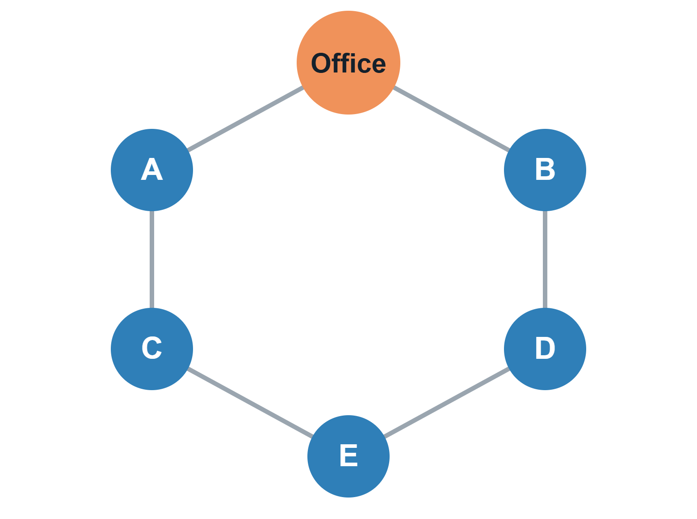
Hostel map: BFS and DFS
CODE WALKTHROUGH
BFS from the Office
Lists blocks nearest first, with hop counts and open requests per block.
bfs(0);
DFS patrol route
A recursive walk that prints the route with open requests in brackets.
dfs(0, vis);
Hostel Maintenance Request Manager · 10/12

Slide 11
Outcomes
CODE WALKTHROUGH
Working application
All five outcomes used
Measured analysis
One C program with 6 student options and 13 admin options, ready to run on sample data.
CO1 to CO5 each power a real feature instead of an isolated demo.
Searches show steps taken and sorts show comparisons and time, so O(n²) and O(n log n) can be compared.
Result: urgent requests are served first, and every request can be tracked from Pending to Resolved.
Hostel Maintenance Request Manager · 11/12

Slide 12
Source code
CODE WALKTHROUGH
GITHUB REPOSITORY
https://github.com/[username]/[repo-name]
Build and run
Logins
Compile with gcc, then start the program.
Student: any name, a block A to E and a room. Admin password: admin123.
gcc hostel_maintenance.c
-o hostel && ./hostel
Thank you. Questions?
Hostel Maintenance Request Manager · 12/12

